Slide 1



Speech Enhancement by Online Non-negative Spectrogram Decomposition in
Non-stationary Noise Environments
1
2
2,3
Zhiyao Duan , Gautham J. Mysore , Paris Smaragdis
1. EECS Department, Northwestern University
2. Advanced Technology Labs, Adobe Systems Inc.
3. University of Illinois at Urbana-Champaign
Presentation at Interspeech on September 11, 2012

Slide 2


Classical Speech Enhancement
Typical algorithms
  Spectral subtraction
  Wiener filtering
  Statistical-model-based (e.g. MMSE)
  Subspace algorithms
Properties
  Do not require clean speech for training (Only pre-learn the noise model)
  Online algorithm, good for real-time apps
  Cannot deal with non-stationary noise
    Most of them model noise with a single spectrum
Keyboard
noise
Bird
noise

Slide 3

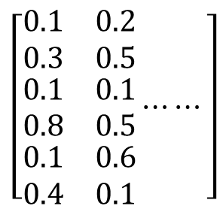
Non-negative Spectrogram Decomposition (NSD)
Uses a dictionary of basis spectra to model a non-stationary sound source
Spectrogram of keyboard noise
Dictionary
Activation weights
$$\left[\begin{aligned}\begin{matrix}0.1 & 0.2 \\ 0.3 & 0.5\end{matrix} \\ \begin{matrix}0.1 & 0.1 \\ 0.8 & 0.5\end{matrix} \\ \begin{matrix}0.1 & 0.6 \\ 0.4 & 0.1\end{matrix}\end{aligned}⋯⋯\right]$$
Decomposition criterion: minimize the approximation error (e.g. KL divergence)

Slide 4
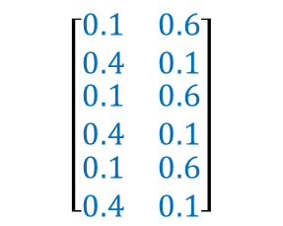
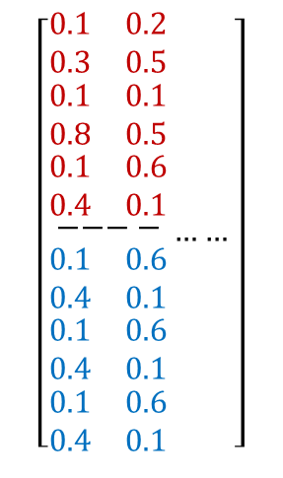
NSD for Source Separation
$$\left[\begin{aligned}\begin{aligned}\begin{matrix}0.1 & 0.2 \\ 0.3 & 0.5\end{matrix} \\ \begin{matrix}0.1 & 0.1 \\ 0.8 & 0.5\end{matrix} \\ \begin{matrix}0.1 & 0.6 \\ 0.4 & 0.1\end{matrix} \\ −−−−\end{aligned} \\ \begin{matrix}0.1 & 0.6 \\ 0.4 & 0.1\end{matrix} \\ \begin{matrix}0.1 & 0.6 \\ 0.4 & 0.1\end{matrix} \\ \begin{matrix}0.1 & 0.6 \\ 0.4 & 0.1\end{matrix}\end{aligned}……\right]$$
Noise weights
Speech weights
Keyboard noise + Speech
Noise dict.
Speech dict.
$$\left[\begin{aligned}\begin{matrix}0.1 & 0.6 \\ 0.4 & 0.1\end{matrix} \\ \begin{matrix}0.1 & 0.6 \\ 0.4 & 0.1\end{matrix} \\ \begin{matrix}0.1 & 0.6 \\ 0.4 & 0.1\end{matrix}\end{aligned}\right]$$
Speech dict.
Speech weights
Separated speech

Slide 5

Semi-supervised NSD for Speech Enhancement
Properties
  Capable to deal with non-stationary noise
  Does not require clean speech for training (Only pre-learns the noise model)
  Offline algorithm
    Learning the speech dict. requires access to the whole noisy speech
Training
Activation weights
Noise-only excerpt
Noise dict.
Separation
Noisy speech
Noise dict. (trained)
Speech dict.
Activation weights

Slide 6
Proposed Online Algorithm
Objective: decompose the current mixture frame
Constraint on speech dict.: prevent it overfitting the mixture frame
Speech weights
Weights of current frame
Noise weights
Weighted buffer frames
(constraint)
Current frame
(objective)
Noise dict. (trained)
Speech dict.
(weights of previous frames were already calculated)

Slide 7
EM Algorithm for Each Frame
Frame
t
?
Frame
t+1
E step: calculate posterior probabilities for latent components
M step: a) calculate speech dictionary
b) calculate current activation weights

Slide 8
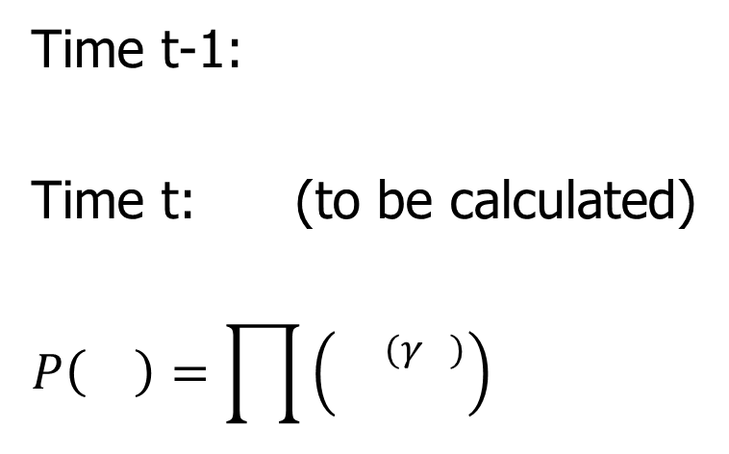
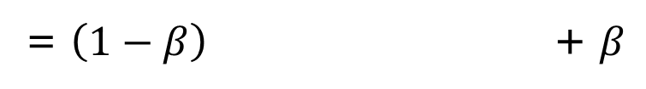
Update Speech Dict. through Prior
Each basis spectrum is a discrete/categorical distribution
Its conjugate prior is a Dirichlet distribution
The old dict. is a exemplar/guide for the new dict.
Time t-1:
Time t: (to be calculated)
$$P\left(\right)=\prod{\left({}^{(γ )}\right)}$$
Prior strength
M step to calculate the speech basis spectrum:
Calculation from decomposing spectrogram
= $\left(1−β\right)$ + $β$
(likelihood part) (prior part)

Slide 9
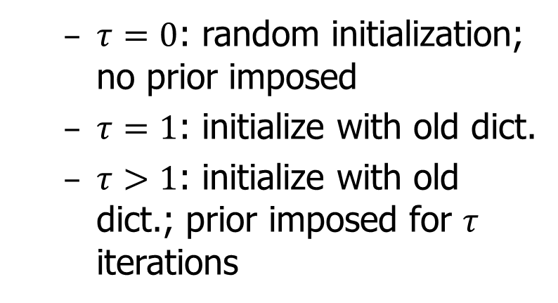
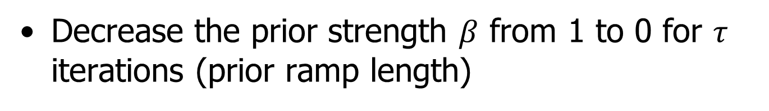


Prior Strength Affects Enhancement
Decrease the prior strength $β$ from 1 to 0 for $τ$ iterations (prior ramp length)
Prior determines
  $τ=0$: random initialization; no prior imposed
  $τ=1$: initialize with old dict.
  $τ>1$: initialize with old dict.; prior imposed for $τ$ iterations
1
$$β$$
Likelihood determines
0
0
$$τ$$
20
#iterations
More restricted speech dict.
Larger $τ$ → stronger prior →
Better noise reduction &
Stronger speech distortion
Less noise &
More distorted speech

Slide 10
Experiments
Non-stationary noise corpus: 10 kinds
  Birds, casino, cicadas, computer keyboard, eating chips, frogs, jungle, machine guns, motorcycles and ocean
Speech corpus: the NOIZEUS dataset [1]
  6 speakers (3 male and 3 female), each 15 seconds
Noisy speech
  5 SNRs (-10, -5, 0, 5, 10 dB)
  All combinations of noise, speaker and SNR generate 300 files
  About 300 * 15 seconds = 1.25 hours
[1] Loizou, P. (2007), Speech Enhancement: Theory and Practice, CRC Press, Boca Raton: FL.

Slide 11
Comparisons with Classical Algorithms
KLT: subspace algorithm
logMMSE: statistical-model-based
MB: spectral subtraction
Wiener-as: Wiener filtering
PESQ: an objective speech quality metric, correlates well with human perception
SDR: a source separation metric, measures the fidelity of enhanced speech to uncorrupted speech
better

Slide 12
better
better

Slide 13

Examples
Keyboard noise: SNR=0dB
 | Spectral subtraction | Wiener filtering | Statistical-model-based | Subspace algorithm | Proposed
PESQ | 1.41 | 1.03 | 1.13 | 0.93 | 2.14
SDR (dB) | 1.82 | 0.27 | 0.70 | 0.18 | 9.62
Larger value indicates better performance

Slide 14
Noise Reduction vs. Speech Distortion
BSS_EVAL: broadly used source separation metrics
  Signal-to-Distortion Ratio (SDR): measures both noise reduction and speech distortion
  Signal-to-Interference Ratio (SIR): measures noise reduction
  Signal-to-Artifacts Ratio (SAR): measures speech distortion
better

Slide 15
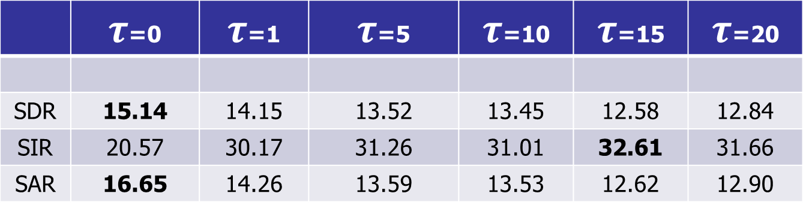
Examples
Bird noise: SNR=10dB
 | $τ$=0 | $τ$=1 | $τ$=5 | $τ$=10 | $τ$=15 | $τ$=20
SDR | 15.14 | 14.15 | 13.52 | 13.45 | 12.58 | 12.84
SIR | 20.57 | 30.17 | 31.26 | 31.01 | 32.61 | 31.66
SAR | 16.65 | 14.26 | 13.59 | 13.53 | 12.62 | 12.90
Larger value indicates better performance
  SDR: measures both noise reduction and speech distortion
  SIR: measures noise reduction
  SAR: measures speech distortion

Slide 16
Conclusions
A novel algorithm for speech enhancement
  Online algorithm, good for real-time applications
  Does not require clean speech for training (Only pre-learns the noise model)
  Deals with non-stationary noise
Classical algorithms
Semi-supervised non-negative spectrogram decomposition algorithm
Updates speech dictionary through Dirichlet prior
  Prior strength controls the tradeoff between noise reduction and speech distortion

Slide 17


Slide 18
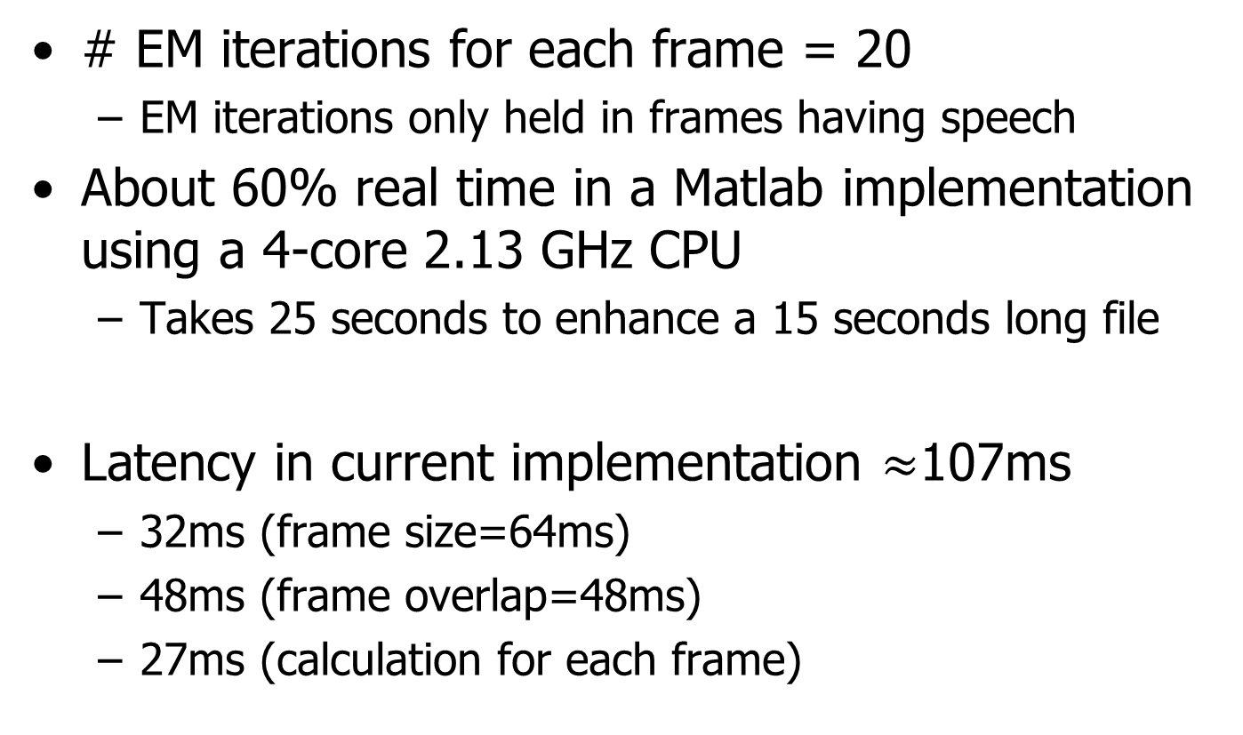
Complexity and Latency
# EM iterations for each frame = 20
  EM iterations only held in frames having speech
About 60% real time in a Matlab implementation using a 4-core 2.13 GHz CPU
  Takes 25 seconds to enhance a 15 seconds long file
Latency in current implementation $≈$107ms
  32ms (frame size=64ms)
  48ms (frame overlap=48ms)
  27ms (calculation for each frame)

Slide 19
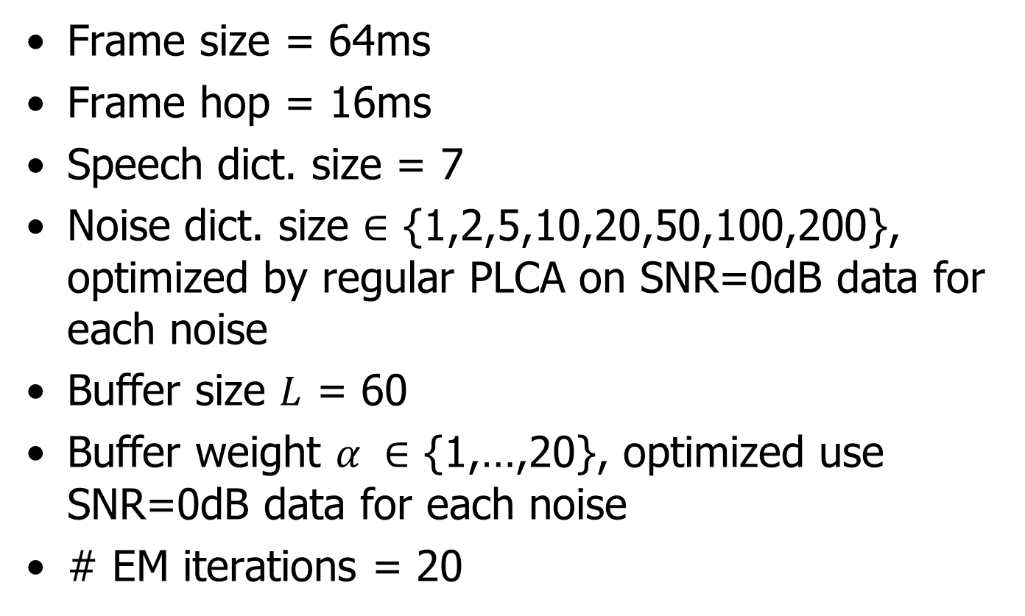
Parameters
Frame size = 64ms
Frame hop = 16ms
Speech dict. size = 7
Noise dict. size $∈$ {1,2,5,10,20,50,100,200}, optimized by regular PLCA on SNR=0dB data for each noise
Buffer size $L$ = 60
Buffer weight $α ∈$ {1,…,20}, optimized use SNR=0dB data for each noise
# EM iterations = 20

Slide 20
Buffer Frames
They are used to constrain the speech dictionary
  Not too many or too old
  We use 60 most recent frames (about 1 second long)
  They should contain speech signals
How to judge if a mixture frame contains speech or not (Voice Activity Detection)?
Notes:
Skip this slide if not enough time

Slide 21
Voice Activity Detection (VAD)
Decompose the mixture frame only using the noise dictionary
  If reconstruction error is large
    Probably contains speech
    This frame goes to the buffer
    Semi-supervised separation (the proposed algorithm)
  If reconstruction error is small
    Probably no speech
    This frame does not go to the buffer
    Supervised separation
Noise dict. (trained)
Noise dict.
(trained)
Speech dict.
(up-to-date)
Notes:
Skip this slide if not enough time

