Slide 1




Online PLCA for Real-Time
Semi-supervised Source Separation
Zhiyao Duan , Gautham J. Mysore , Paris Smaragdis
1. EECS Department, Northwestern University
2. Advanced Technology Labs, Adobe Systems Inc
3. University of Illinois at Urbana-Champaign
Presentation at LVA/ICA on March 14, 2012
1
2
2,3

Slide 2

Real-time Source Separation is Important
Speech denoising in teleconference
  Source 1: noise (e.g. computer keyboard)
  Source 2: speech
Online separation algorithms are needed
Video Chatting

Slide 3

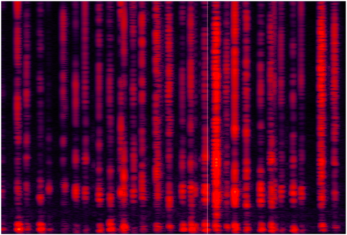

Spectrogram Decomposition
Probabilistic Latent Component Analysis (PLCA)
Nonnegative Matrix Factorization (NMF)
Activation weights of basis spectra
Dictionary of basis spectra
Observed spectra
Minimize reconst. error
Reconstructed spectra
dict.,
weights

Slide 4
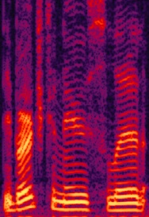
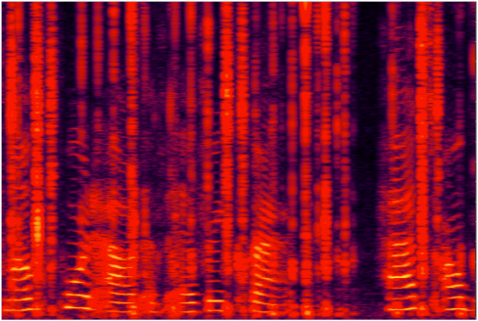
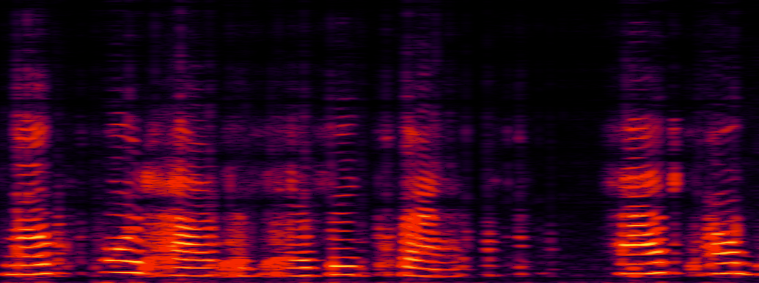
Supervised Separation: Easy Online
Train source dictionaries:
Trained dict. for Source 1
Trained dict. for Source 2
Decompose sound mixture:
Activation weights
Source dict.’s
Reconstruct Source 2:

Slide 5

Semi-supervised Separation: Offline
Train source dictionaries:
No Training Data!
Trained dict. for Source 1
Trained dict. for Source 2
Decompose sound mixture:
Activation weights
Source dict.’s
Reconstruct Source 2:

Slide 6

Problem
Spectrogram decomposition-based semi-supervised separation is offline
Not applicable for
  Real-time separation
  Very long recordings
Can we make it online?

Slide 7
The First Attempt
Objective: decompose the current mixture frame well
Do semi-supervised source separation on the current mixture frame
Mission Impossible!
  Many more unknowns than equations
  Learned S2’s dictionary will be almost the same as the mixture frame (overfitting)
Need to constrain S2’s dictionary!
S1 dict. (given)
S2 dict.
S2 dict.
Separated S2

Slide 8
Proposed Online Semi-supervised PLCA
Decompose the current mixture frame and some previous mixture frames (called running buffer)
S1 weights
Weights of current frame
S2 weights
Buffer frames
(constraint)
Current frame
(objective)
S1 dict. (trained)
S2 dict.
(weights of previous frames are already learned)
Current frame reconst. error
Tradeoff
Buffer frames reconst. error
S2 dict.,
Weights of current frame
Buffer size

Slide 9
Update S2’s Dictionary
Frame
t
Frame
t+1
Warm initialization

Slide 10
Buffer Frames
Not too many or too old
  Otherwise algorithm will be slow, and constraints might be too strong
  We used 60 most recent, qualified frames (about 1 second long)
Qualified: must contain S2’s signals
  They are used to constrain S2’s dictionary
How to judge if a mixture frame contains S2 or not?

Slide 11
Which Mixture Frame Contains S2?
Assume: Mixture = S1 + S2
Decompose the mixture frame only using S1’s dictionary
  If reconstruction error is large
    Probably contains S2
    Semi-supervised separation using S1’s dict. (the proposed algorithm)
    This frame goes to the buffer
  If reconstruction error is small
    Probably no S2
    Supervised separation using S1’s dict. and S2’s up-to-date dict.
    This frame does not go to buffer
S1 dict. (trained)
S1 dict. (trained)
S2 dict.
(up-to-date)

Slide 12
Advantages
The learned S2’s dictionary avoids overfitting the current mixture frame
Compared to offline PLCA, the learned S2’s dictionary is learned from the current frame and buffer frames
  Smaller (more compact)
  More localized
  Constantly being updated
Convergence is fast at each frame
  Since from Frame t to t+1, the S2’s dictionary has a warm initialization

Slide 13
Experiments – Data Set
Speech denoising
  S1 = noise: train noise dictionary beforehand
  S2 = speech: update speech dictionary on the fly
10 kinds of non-stationary noise
  Birds, casino, cicadas, computer keyboard, eating chips, frogs, jungle, machine guns, motorcycles and ocean
6 speakers (3 male and 3 female), from [1]
5 SNRs (-10, -5, 0, 5, 10 dB)
All combinations generate our noisy speech dataset
  About 300 * 15 seconds = 1.25 hours
[1] Loizou, P. (2007), Speech Enhancement: Theory and Practice, CRC Press, Boca Raton: FL.

Slide 14
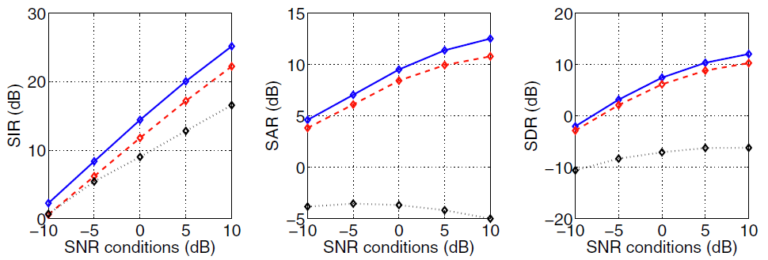
Experiments – Results (1)
Offline PLCA (20 speech bases)
Proposed online PLCA (7 speech bases)
Online NMF (O-IS-NMF), [Lefèvre et al, 2011]
  not designed for separation; designed for learning dictionaries

Slide 15
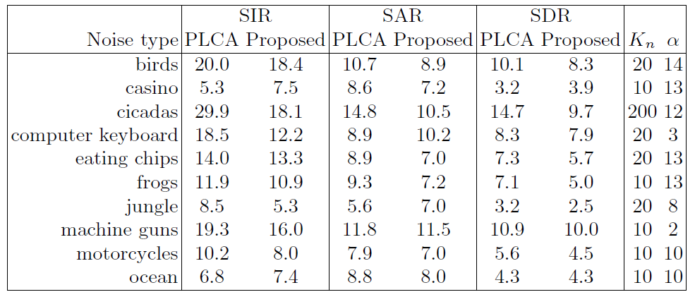
Experimental Results (2)
Noise dict. size
Tradeoff: constraint vs. objective

Slide 16
Examples
Speech + computer keyboard noise
Speech + bird noise
SNR=10dB | Noisy speech | Offline PLCA | Online PLCA
SDR (dB) | 10.0 | 9.8 | 12.9
SIR (dB) | 10.0 | 26.0 | 20.7
SAR (dB) | 75.4 | 9.9 | 13.7
Noisy speech
SNR=5dB | Noisy speech | Offline PLCA | Online PLCA
SDR (dB) | 5.0 | 11.3 | 9.9
SIR (dB) | 5.0 | 27.8 | 23.5
SAR (dB) | 77.2 | 11.4 | 10.1

Slide 17

Conclusions
Proposed an online-PLCA algorithm for semi-supervised source separation
Algorithmic properties
  Learns a smaller, more “localized” dictionary
  Fast convergence in each frame
Achieved almost as good results as offline PLCA, and significantly better than an existing online NMF algorithm

Slide 18


